Slide 1
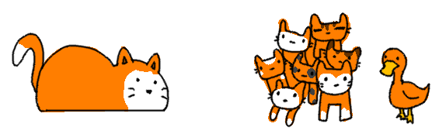
Classes & Inheritance
CS 201, Summer 2013

Slide 2
ADDITIONAL READING
Classes
  Chapter 6 & 7 of Pearson book
Inheritance
  Chapter 14 of Pearson book

Slide 3
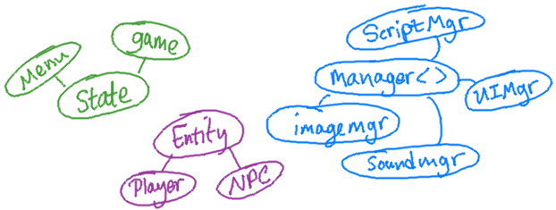
Object Oriented Programming (“OOP”)
Object Oriented Programming is a programming paradigm, a way of designing your software to (hopefully) keep it modular and easy to maintain and add on to.

Slide 4
Applications?
Online retail
In-store P.O.S.
Business management
Simulation
  Traffic, War, etc.
Accessibility tools
  Text to speech
So many applications...
Have a problem? How can we apply software to it?
What is an area that software couldn't help at all?

Slide 5
Classes & Inheritance
Think of Classes as a set of functionality and attributes (variables).
Remember that classes can inherit from other classes. We can start with something general, and make a specialized version of it.
Programming & Software Development is about taking real-world problems, and abstracting them to computer code.

Slide 6
A messy program
Display menu option 1 (deposit)
Display menu option 2 (withdraw)
If user enters option 1
  Ask for amount
  If amount > maxDepositAmount
    leftover = maxDepositAmount – amount
    balance += maxDepositAmount
    HeldFunds.add( leftover )
  else
    balance += amount
Else if user enters option 2
  Ask for amount
  ...

Slide 7
An Object-Oriented program
userInterace.DisplayMenu()
choice = userInterface.GetUserChoice()
if choice is DEPOSIT
  amount = userInterface.GetDollarValue()
  bank.HandleDeposit( amount );
else if choice is WITHDRAW
  amount = userInterface.GetDollarValue()
  bank.HandleWithdraw( amount );
userInterface.DisplayBalance( bank.GetBalance() )
We can have multiple objects that have a set of functionality they are responsible for.
The objects can also store variables.
We delegate tasks to classes and their functions.

Slide 8
Other Objects...
EBOOK
Functions:
TurnPageForward( )
TurnPageBackward( )
GoToPage( pageNum)
BookmarkCurrentPage( )
Variables:
currentPage
currentBookTitle
currentChapterTitle
CAR
Functions:
TurnOn( )
SetGear( gear )
PressGasPedal( )
Variables:
currentGear
isOn
distanceTravelled

Slide 9
Other Objects...
WINDOW
Functions:
InitializeWindow( )
ResizeWindow( )
CloseWindow( )
Draw( )
Variables:
x, y coordinates
width, height
backgroundColor
buttonList
BUTTON
Functions:
Setup( x, y, w, h, color, text )
Draw( )
IsClicked( mouseX, mouseY )
Variables:
x, y coordinates
width, height
backgroundColor
text

Slide 10
Other Objects...
UNIVERSITY
Functions:
addClass( name, prereqs, dept )
setClassSchedule( semester )
Variables:
classList
CLASS
Functions:
Setup (name, prereqs, dept )
AddStudent( student )
DropStudent( student )
AddTeacher( teacher )
Variables:
name
prereqList
studentList
department
schedule
teacher
STUDENT
Variables:
name
major
classesTaken

Slide 11
What about similar objects?
WINDOW
Functions:
InitializeWindow( )
ResizeWindow( )
CloseWindow( )
Draw( )
Variables:
x, y coordinates
width, height
backgroundColor
buttonList
BUTTON
Functions:
Setup( x, y, w, h, color, text )
Draw( )
IsClicked( mouseX, mouseY )
Variables:
x, y coordinates
width, height
backgroundColor
text
Duplicate code is bad because you end up having to update multiple places with the same functionality, rather than updating one section of code.
Shouldn't they have a chunk of code in common?

Slide 12
What about similar objects?
WIDGET
Functions:
Draw( )
Variables:
x, y coordinates
width, height
backgroundColor
With a common “Widget” class, we can handle any sort of functionality relating to coordinates, dimensions, color, and drawing to the screen.
Draw() {
SetDrawColor( backgroundColor )
DrawRectangle( x, y, width, height );
}
BUTTON inherits WIDGET
Functions:
Setup( x, y, w, h, color, text )
IsClicked( mouseX, mouseY )
Variables:
text
WINDOW inherits WIDGET
Functions:
InitializeWindow( )
ResizeWindow( )
CloseWindow( )
Variables:
buttonList

Slide 13
What about similar objects?
WIDGET
Functions:
Draw( )
Variables:
x, y coordinates
width, height
backgroundColor
If we decide to change how our widgets draw now, BUTTON and WINDOW will automatically be updated:
Draw() {
// SetDrawColor( backgroundColor )
// DrawRectangle( x, y, width, height );
SetDrawGradient( backgroundColor, WHITE )
DrawRoundedRectangle( x, y, width, height );
}
X
Old Window
New Window
X
Old Button
New Button
* Inappropriate, tacky use of gradients. Will be punished by neared UX designer.

Slide 14


Another example...
PLAYER
Functions:
Move( keyboard )
Draw( screen )
Variables:
velocityX
velocityY
x, y
width, height
image
ENEMY
Functions:
Move()
Draw( screen )
Variables:
velocityX
velocityY
x, y
width, height
image
In a video game, the player and the enemy both have similar functionality –
Both have an image
Both have coordinates & dimensions
Both have a velocity
Both get drawn to the screen
Both move
However, the player movement is dependent on keyboard (or gamepad) input.
The enemy movement is based on AI, where it has to decide where to move next.

Slide 15
Another example...
PLAYER
Functions:
Move( keyboard )
ENTITY
Functions:
Move()
Draw( screen )
Variables:
velocityX
velocityY
x, y
width, height
image
We can create a base entity object that handles all of the generic, shared functionality and variables held by both.
Then when we create a player...
Player bunny;
And call Draw...
bunny.Draw( screen );
The Player class automatically calls its parent (Entity)'s Draw function.
ENEMY
Functions:
Move()

Slide 16
Public, Protected, and Private
A class can classify its members (variables & functions) as...
  Public: The variable or function can be accessed anywhere.
  Protected: The variable or function can only be accessed from within the class itself, and its children.
  Private: The variable or function can only be accessed from within the class itself, and not its children.

Slide 17
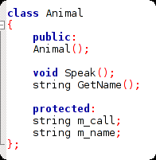
Inheriting...
Here we have a simple Animal class which has a variable m_call, which stores the animal's call.

Slide 18
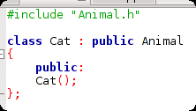
Inheriting...
We then create a class Cat, which inherits from Animal. We add a constructor explicitly, but Speak(), GetName(), and the variables are automatically part of Cat class.

Slide 19
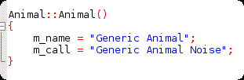
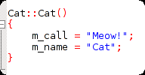
Inheriting...
Within the constructors, we can setup specifics about the class. We could also add additional functionality for Cat that might not be present in generic Animal.

Slide 20
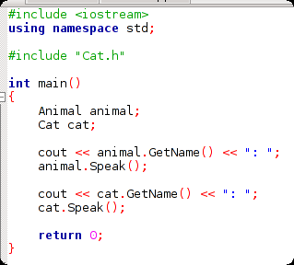
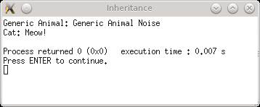
Inheriting...
Now we can use either a generic Animal in our program, or a specific animal implemented in a class inherited from Animal.
We can, in a sense, create an “Animal” interface – a list of “Functionality” that every Animal can “perform”, and then create specific instances of a given Animal.

Slide 21
More practical uses...
Email attachment class – Create different types of attachments, which are handled differently.
User Interface – Every visual object has (x,y) coordinates, dimensions, and color in common, which can be extended.
Entity – Types of entities in a video game (Player, NPC, enemy, pickup item)
What might have common functionality & attributes, but also might need to be extended further in different directions?

Slide 22
Inheritance: Redefine vs. Overload
When you inherit a class, the parent class' public and protected members are automatically available to the child.
We can also override those functions to change the behavior.
  For example, the Player moves based on keyboard input, but the Enemy moves based on AI.

Slide 23
Inheritance: Redefine vs. Overload
When you Overload a function, the original function is still available – you just have a second option based on unique parameters.
When you Redefine a function, you override its functionality for a specific child class.

Slide 24
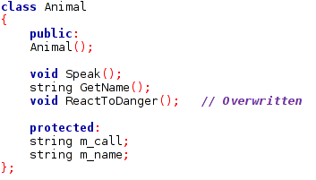
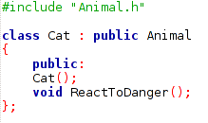


Inheritance: Redefine vs. Overload
To redefine a function, we must redeclare the function within the child class. Then, we can write the function definition (the actual body of the function) with the new behavior.

Slide 25
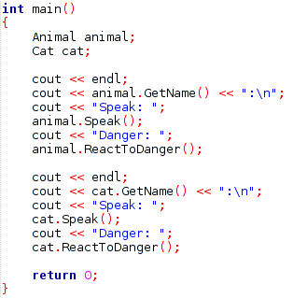
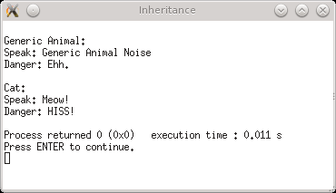
Inheritance: Redefine vs. Overload
Our specialized Cat class now has a different behavior for “ReactToDanger” than the generic Animal.

Slide 26
Inheritance: Constructors & Destructors
Along with member functions, constructors and destructors can also be overridden.
constructors are special functions that are automatically called on a class instantiation (ie, when you declare a new variable with that class)
destructors are special functions that are automatically called when an instance is destroyed (ie, goes out of scope).

Slide 28
Inheritance: Multiple Inheritance
In C++, a class can also inherit from more than one parent classes. This might be handy for an object inheriting different types of traits-
  An NPC is both drawable and AI_Controlled, so it might inherit different functionalities from two parent classes.
  An “Image Button” might inherit properties from an Image and a Button class.

Slide 29
Also, Composition...
Composition can be just as important as Inheritance.
Composition is merely giving a class a member variable, which is another class.
ENEMY
Functions:
Update()
Members:
AI_CONTROLLED control
AI_CONTROLLED
Functions:
Move()

